Slide 1



United for Ethics in Sport Community Codes
United for Ethics in Sport

Slide 2


What is ethics and its purpose?
Ethics are a set of archetypes, models, and ideals that shape
a person's character and action. As a result, ethics refers to
a set of behavioural and lifestyle norms that help people recognize
the value of the good.
United for Ethics in Sport

Slide 3



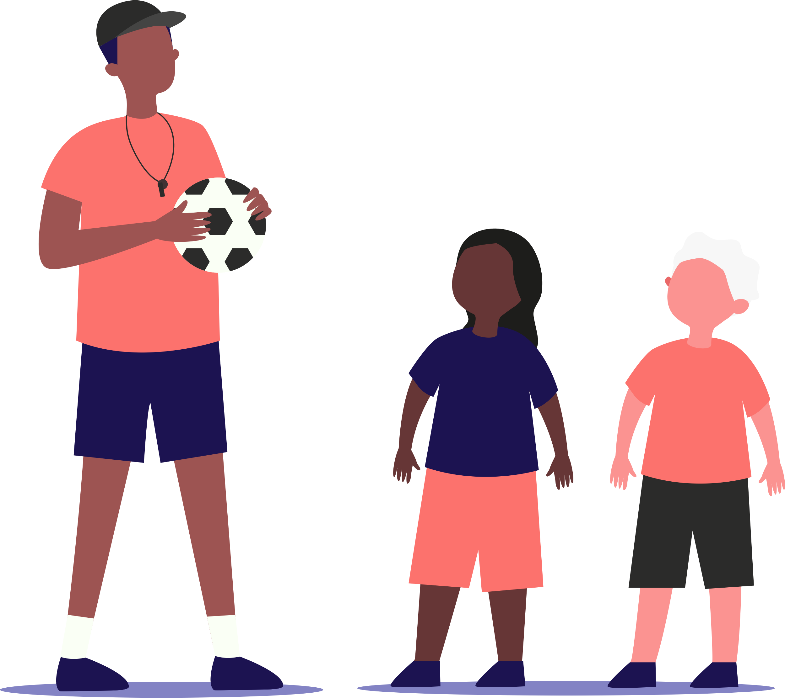
Why ethics in sports
Ethics, as a set of principles, helps us to understand that we cannot live
in any way, that not everything is permissible in life and that
our actions have outcomes for others and the society that we help
to build. Ethics guide us to define good from bad and right from wrong.
United for Ethics in Sport

Slide 4
Why ethics in sports
The same view should be used for the practice of sport:
Individual goals or triumph should not be the primary goal
and they should not be achieved at any cost, but they should indicate
values such aseffort, respect, tolerance and fairness.
United for Ethics in Sport

Slide 5

What are the
UES community codes for ethical sports?
United for Ethics in Sport

Slide 6


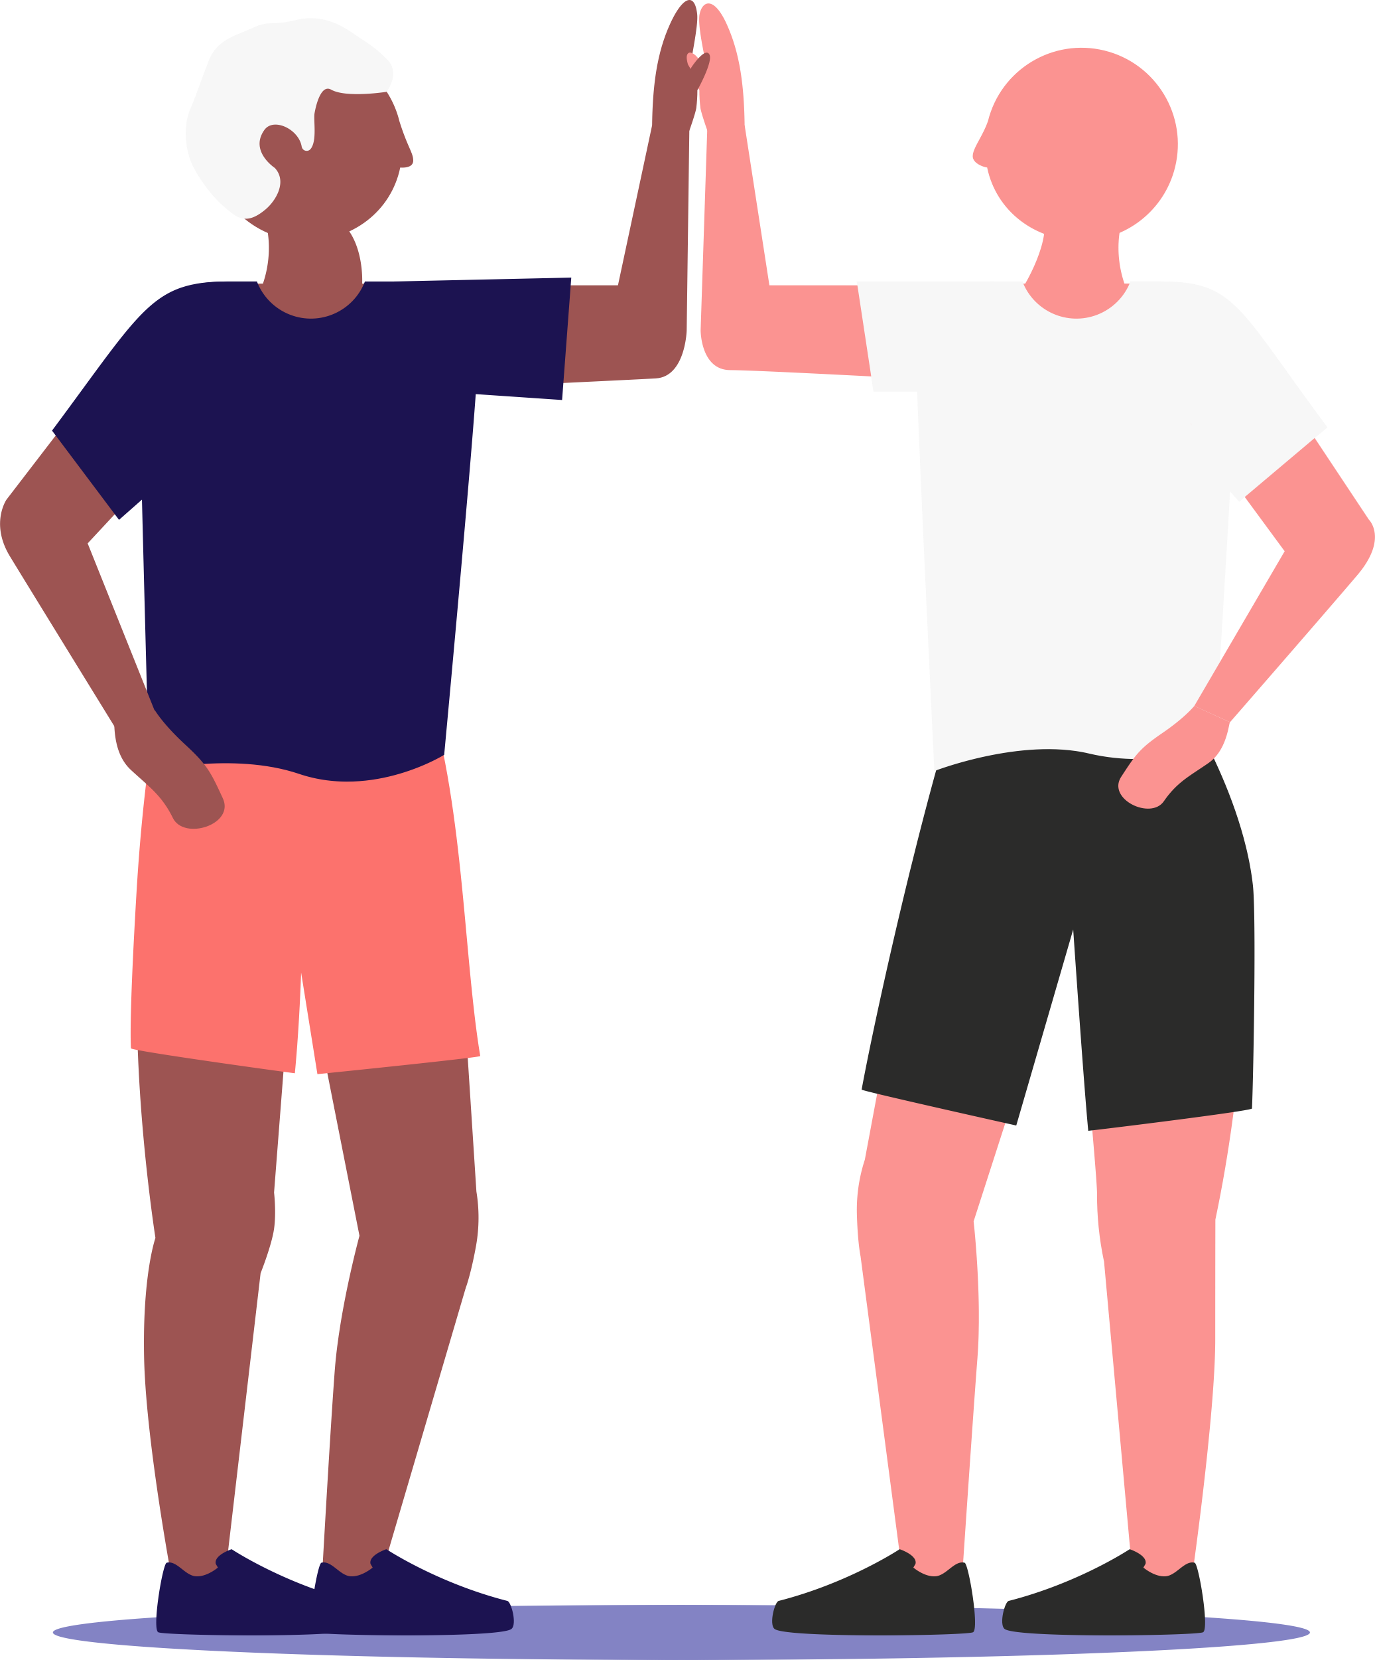

We treat everyone equally.
Regardless of nationality, age, gender, sexual orientation,
social origin, religion or political orientation.
United for Ethics in Sport

Slide 7

We bring sport and the social environment into harmony.
By combining the demands of training and competition with
education, work and family life.
United for Ethics in Sport

Slide 8

We foster personal and collective responsibility.
And involve athletes in all decisions that affect them.
United for Ethics in Sport

Slide 9

We support respectfully.
Without overtaxing athletes, because achieving sporting targets
cannot come at the expense of their physical or mental health.
United for Ethics in Sport

Slide 10

We educate for fairness and environmental responsibility.
Our behaviour towards one another and in relation to nature
is characterised by respect.
United for Ethics in Sport

Slide 11
We condemn violence, exploitation and sexual assault.
We take a zero-tolerance approach and take incisive action
against it, regardless of whether such aggression is
physical or psychological.
United for Ethics in Sport

Slide 12

We say no to doping and drugs.
We educate and intervene immediately if prohibited
substances are administered or distributed.
United for Ethics in Sport

Slide 13

We refrain from tobacco and alcohol during sports.
In addition, we show the risks and effects of consumption
at an early stage.
United for Ethics in Sport

Slide 14

We oppose all forms of corruption.
We exercise total transparency when dealing with conflicts of
interest, gifts, finances and betting.
United for Ethics in Sport

Slide 15
What happens if ethical values are not considered in sports?
Bribery issues | Exploitation of athletes
Match fixing | Doping
Low salary | Cheating
United for Ethics in Sport

Slide 16

Therefore, it is important to follow the presented codes to achieve respect, tolerance and fairness in any kind of sports.
United for Ethics in Sport

Slide 17
Join the UES community on
Facebook and Instagram to get the latest news about ethics in sports!
United for Ethics in Sport

